Slide 1

Let’s Agree to Disagree: A Meta-Analysis of Disagreement Among Crowdworkers During Visual Question Answering
Anuparna Banerjee, Samridhi Ojha and Danna Gurari
School of Information
University of Texas at Austin
anuparna.banerjee@utexas.edu; samojha2@gmail.com; danna.gurari@ischool.utexas.edu

Slide 2
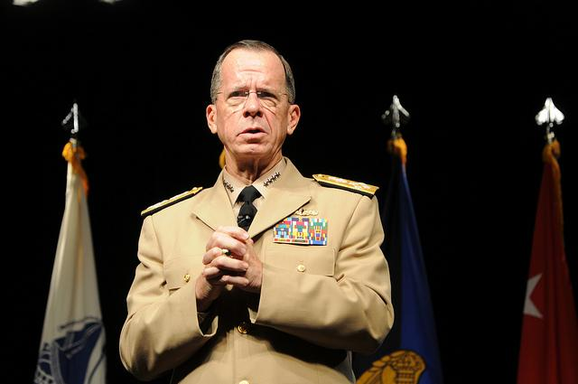
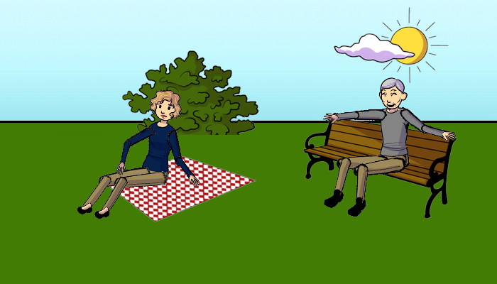
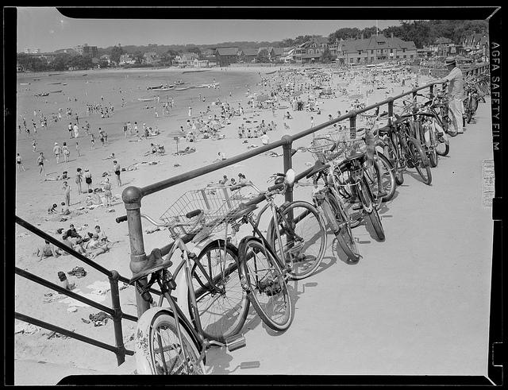
Why Visual Question Answering (VQA) Matters?
What color is the man’s jacket?
Who looks happier?
Are the bikes safe?
Notes:
Crowd workers may not converge on a single response for some questions on VQA such as on this slide . We want to know why some visual questions may have multiple responses.

Slide 3
How Crowd Responds to Visual Questions?
What color is the man’s jacket?
beige
tan
beige
tan
khaki
tan
tan
tan
tan
tan
Who looks happier?
Old person
man
man
man
Old person
man
man
man
man
grandpa
Are the bikes safe?
yes
yes
yes
no
yes
yes
yes
no
yes
yes
Notes:
Crowd can respond differently
For example, we observe high agreement for “yes/no" visual questions for both VQA datasets. Still, such visual questions do evoke disagreements, such as when they are seeking subjective information (e.g., “Does this picture look scary?", Figure 2g). In addition, we observe moderate to high levels of agreement for “number" visual questions. We hypothesize the greater likelihood for disagreement for the real images than for the abstract scenes arises (Crowdverge)

Slide 4
Problem
Machines are trained to predict a single answer to a visual question.
What color is the man’s jacket?
beige
tan
beige
tan
khaki
tan
tan
tan
tan
tan
Who looks happier?
Old person
man
man
man
Old person
man
man
man
man
grandpa
Are the bikes safe?
yes
yes
yes
no
yes
yes
yes
no
yes
yes
Notes:
For example, we observe high agreement for “yes/no" visual questions for both VQA datasets. Still, such visual questions do evoke disagreements, such as when they are seeking subjective information (e.g., “Does this picture look scary?", Figure 2g). In addition, we observe moderate to high levels of agreement for “number" visual questions. We hypothesize the greater likelihood for disagreement for the real images than for the abstract scenes arises (Crowdverge)

Slide 5
Research Questions
Why does the crowd disagree over the answers to visual questions?
Do different user-interfaces affect what is perceived as the reason for crowd-disagreement over the answers?
Notes:
For example, we observe high agreement for “yes/no" visual questions for both VQA datasets. Still, such visual questions do evoke disagreements, such as when they are seeking subjective information (e.g., “Does this picture look scary?", Figure 2g). In addition, we observe moderate to high levels of agreement for “number" visual questions. We hypothesize the greater likelihood for disagreement for the real images than for the abstract scenes arises (Crowdverge)

Slide 6
Research Questions
Why does the crowd disagree over the answers to visual questions?
Do different user-interfaces affect what is perceived as the reason for crowd-disagreement over the answers?
Notes:
For example, we observe high agreement for “yes/no" visual questions for both VQA datasets. Still, such visual questions do evoke disagreements, such as when they are seeking subjective information (e.g., “Does this picture look scary?", Figure 2g). In addition, we observe moderate to high levels of agreement for “number" visual questions. We hypothesize the greater likelihood for disagreement for the real images than for the abstract scenes arises (Crowdverge)

Slide 7
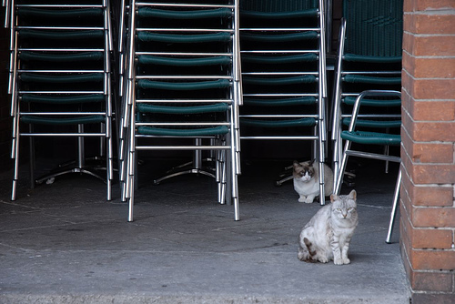
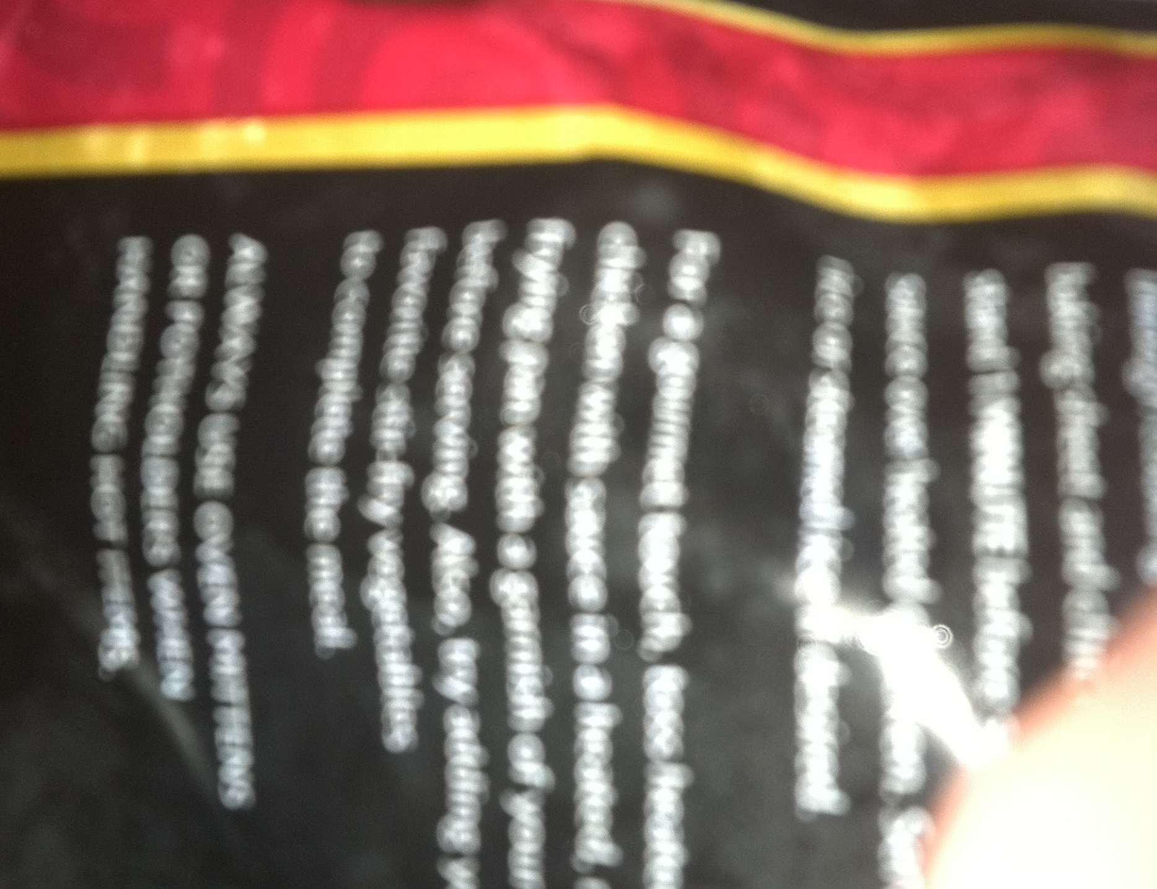
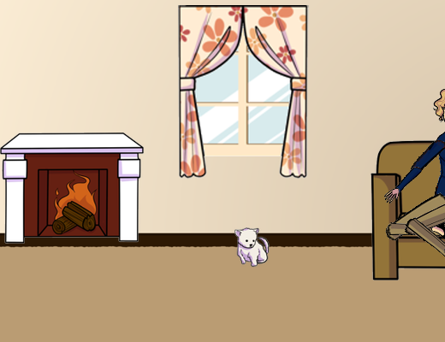
Datasets
VQA Real Images
48 visual questions
VizWiz Images
48 visual questions
VQA Abstract Scenes
48 visual questions
How many chairs are there in this picture?
What item is this?
What color are the plates?
Notes:
Decribe datasets.

Slide 8
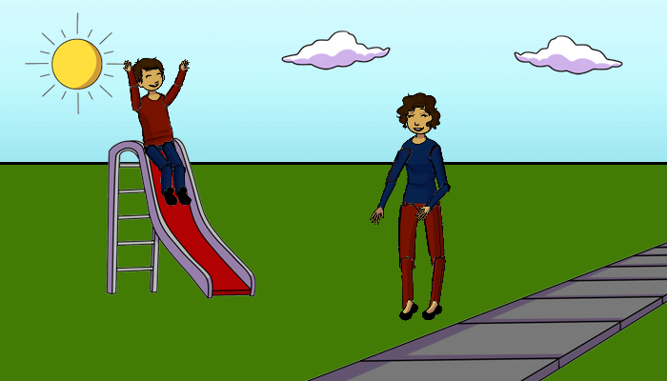
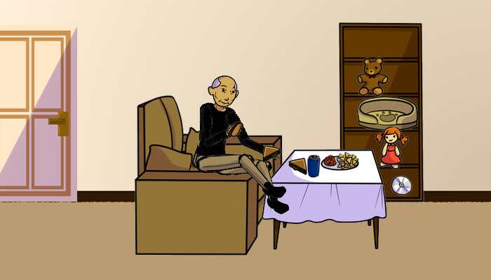
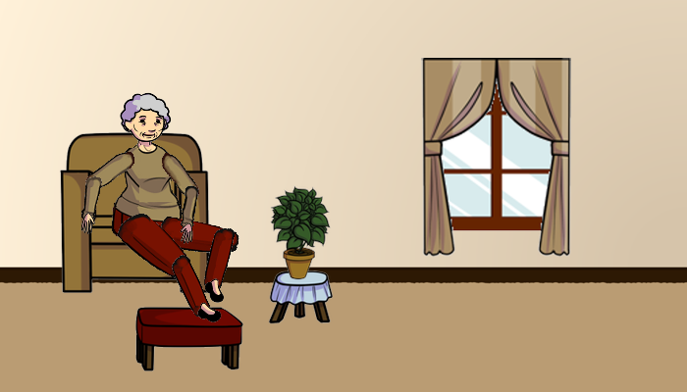
Entropy Differences
What is the woman doing?
Smiling
watching
watching boy
standing
laughing
watching boy
standing
laughing
standing
watching
What color is the carpet?
beige
beige
beige
brown
tan
beige
tan
tan
brown
cream
Does the woman have curly hair?
yes
yes
yes
yes
yes
yes
no
yes
no
yes
High Entropy Answers Low Entropy Answers
We looked at images where the crowd disagreed on at least 1 response.

Slide 9
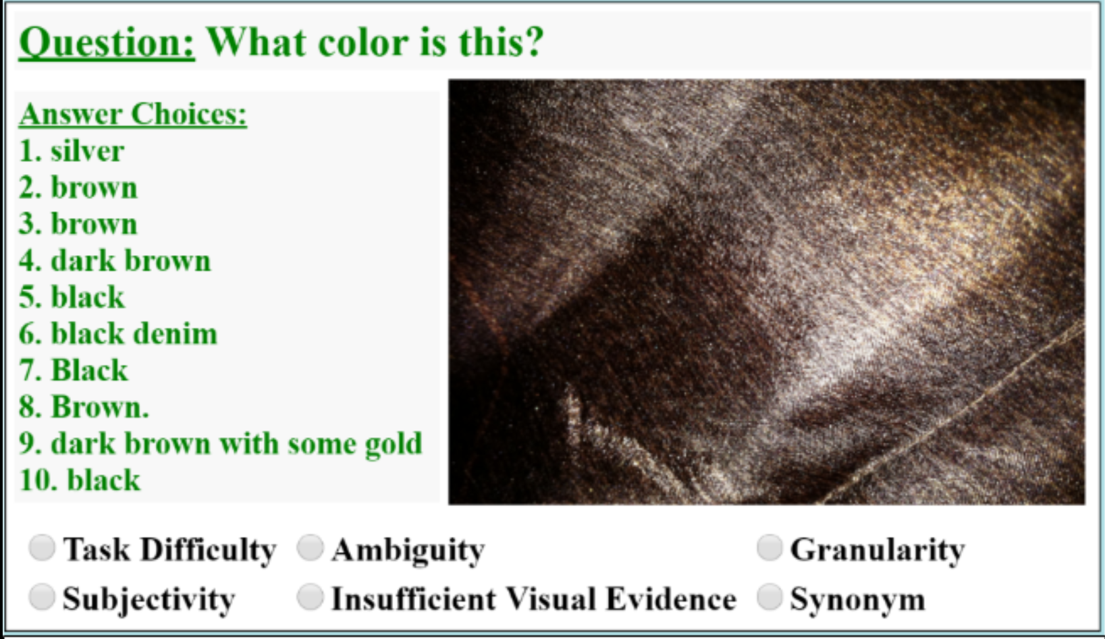
Reasons of Disagreement
6 different reasons of crowd disagreement over answers.
Courtesy: Danna Gurari and Kristen Grauman. "CrowdVerge: Predicting If People Will Agree on the Answer to a Visual Question." Proceedings of the 2017 CHI Conference on Human Factors in Computing Systems. ACM, 2017.

Slide 10
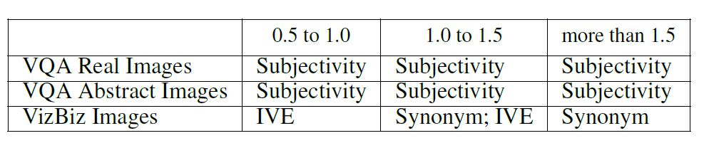
Why is there a disagreement?
Low Entropy Answers High Entropy Answers
Subjectivity is the major reason of disagreement for VQA Real and Abstract Images.
Insufficient Visual Evidence is the reason of disagreement for VizWiz Images.
Notes:
Put entropy arrows

Slide 11
Research Questions
Why does the crowd disagree over the answers to visual questions?
Do different user-interfaces affect what is perceived as the reason for crowd-disagreement over the answers?
Notes:
For example, we observe high agreement for “yes/no" visual questions for both VQA datasets. Still, such visual questions do evoke disagreements, such as when they are seeking subjective information (e.g., “Does this picture look scary?", Figure 2g). In addition, we observe moderate to high levels of agreement for “number" visual questions. We hypothesize the greater likelihood for disagreement for the real images than for the abstract scenes arises (Crowdverge)

Slide 12
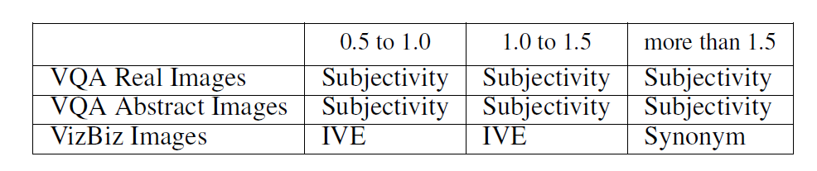
Does using checkboxes change the crowd opinion?
Low Entropy Answers High Entropy Answers
Same results as the radio button interface!

Slide 13
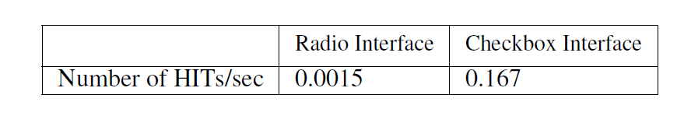
Does using checkboxes change the crowd opinion?
Crowd-workers provide results faster on a checkbox interface than radio button interface.

Slide 14
Conclusion
Why does the crowd disagree over the answers to visual questions?
Subjectivity is the major reason of disagreement for VQA Real and Abstract Images.
Insufficient Visual Evidence is the reason of disagreement for VizWiz Images.
Do different user-interfaces affect what is perceived as the reason for crowd-disagreement over the answers?
Crowd provides results faster on checkbox interface than on radio button interface.
Notes:
For example, we observe high agreement for “yes/no" visual questions for both VQA datasets. Still, such visual questions do evoke disagreements, such as when they are seeking subjective information (e.g., “Does this picture look scary?", Figure 2g). In addition, we observe moderate to high levels of agreement for “number" visual questions. We hypothesize the greater likelihood for disagreement for the real images than for the abstract scenes arises (Crowdverge)

